Slide 1
Lecture 9

Slide 2
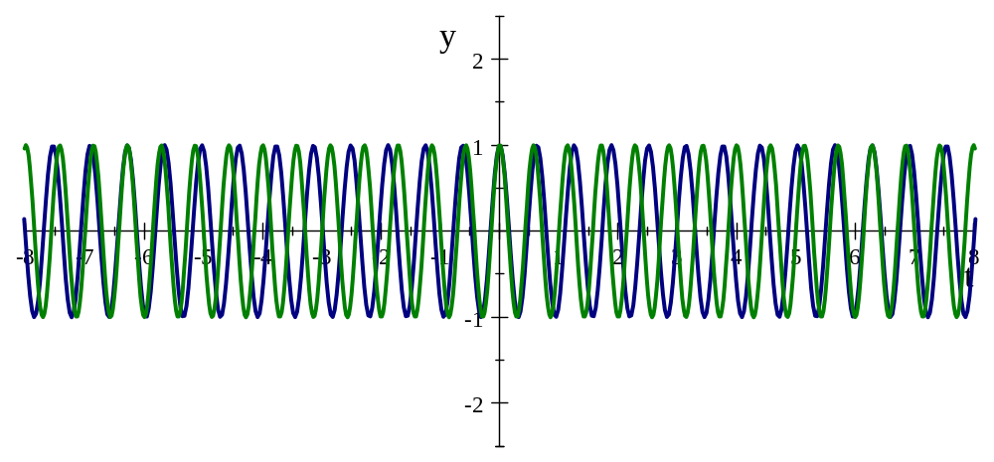


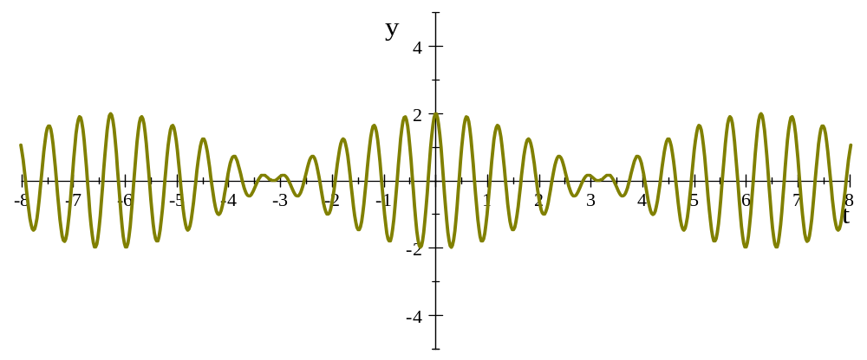

Example of Beats

Slide 3
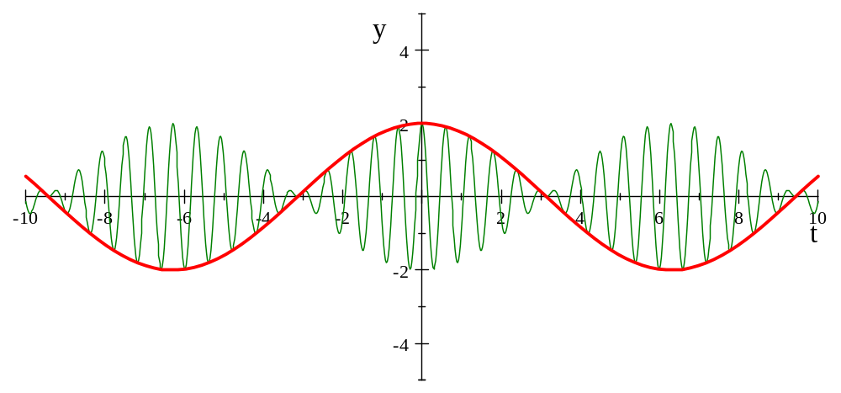

Slide 4
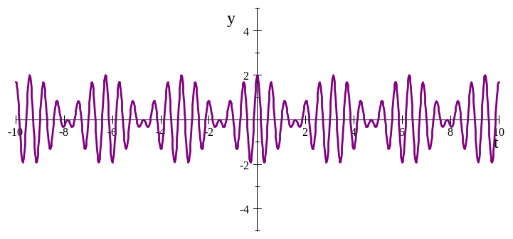
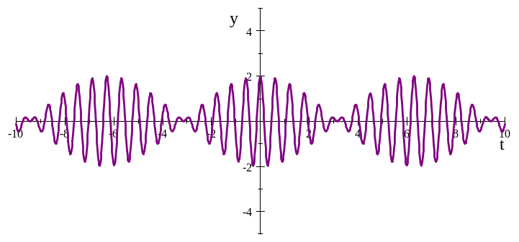
Question 223.9.1
Two graphs are shown below. Each graph represents the result of adding two waves together. For which graph is the frequency difference greater between the two original waves?.
A
B

Slide 5
Question 223.9.2
You are tuning a guitar by comparing the sound of the string with that of a standard tuning fork. You notice a beat frequency of 5Hz. You tighten the guitar string and the beat frequency rises to 8Hz. In order to tune the string exactly to the tuning fork, you should
Continue to tighten the string
Loosen the string
Impossible to determine

Slide 6
Question 223.5.1 123.22.13
You are a parent standing at platform 9.75. The Hogwarts Express is just leaving the station. The whistle blows. The engineer (if there is one) hears a perfect middle C (256 Hz). What do you hear as the train leaves?
A higher pitch than 256 Hz
A lower pitch than 256 Hz
Middle C (256 Hz)
Nothing

Slide 7
Inertial Frames
Remember Inertial Reference Frames
  The two observers can both take the view that they are stationary
  Newton’s laws are all good in either frame
y
v_{BA}
A
B
x

Slide 8
Demonstration
https://astro.unl.edu/classaction/animations/light/dopplershift.html
https://ophysics.com/w11.html

Slide 9
Spherical Emitter Setup
Spherical Wave Crests
Detector
Point Source

Slide 10
Moving Detector

Slide 11
Moving Detector

Slide 12
Question 223.5.2 Question 123.22.14
A train passes you while blowing its whistle. Describe the frequency change
The change is nearly instantaneous
The change is gradual, as the train approaches the frequency changes proportionately with the distance from you
The change is gradual, as the train approaches the frequency changes inverse proportionately with the distance from you
Can’t tell

Slide 13
Question 223.5.3 Question 123.22.15
You are sitting on the Hogwarts Express. It is just leaving the station. The whistle blows. The engineer (if there is one) hears a perfect middle C (256 Hz). What do you hear as the train leaves?
A higher pitch than 256 Hz
A lower pitch than 256 Hz
Middle C (256 Hz)
Nothing

Slide 14
Question 223.5.4.1
You are playing your Irish tin whistle at 440Hz. Your friend runs toward you at 10m/s. What frequency does your friend hear? (take 343m.s as the speed of sound)
453.8Hz
427.1Hz
453.2
427.5

Slide 15

Top: Normal 'dark' spectral line positions at rest. Middle: Source moving away from observer. Bottom: Source moving towards observer. (Public domain image courtesy NASA: http://www.jwst.nasa.gov/education/7Page45.pdf)

Slide 16
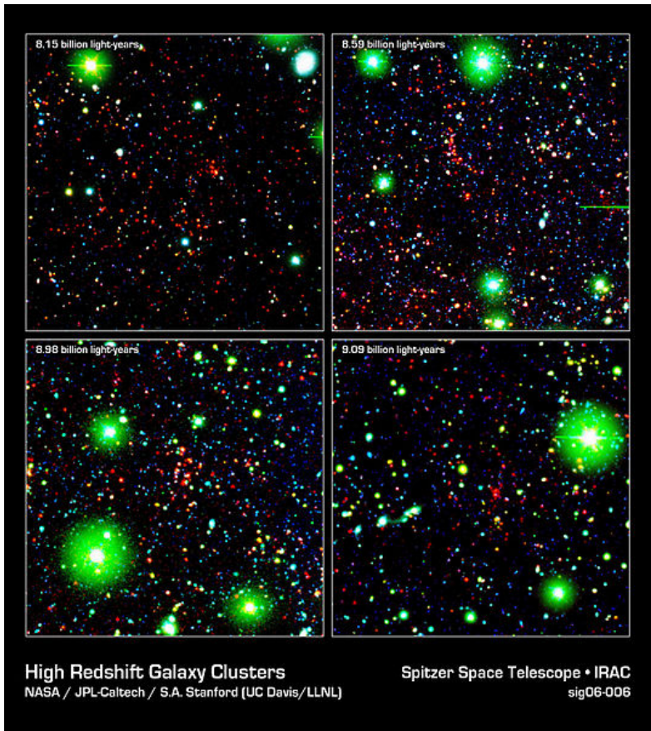
High Redshift Galaxy Cluster shown here in false color from the Spitzer Space Telescope. (Public domain image courtesy NASA/JPL-Caltech/S.A. Stanford (UC Davis/LLNL)

Slide 17
END

Slide 18
Question 225.5.4
Often a single jet will create two sonic booms, why?
One is from the plane and one is from the condensation trail that follows the plane
The nose and the tail both act as wave sources
One is from the plane and one is a Newton's third law reaction

